Slide 1
Risk Assessment for anthropogenic influence on surface waters via groundwater
Status June 2025
Trace elements: As, Ba, Pb, Cd, Cr, Cu, Hg, Ni, Zn.

Slide 2
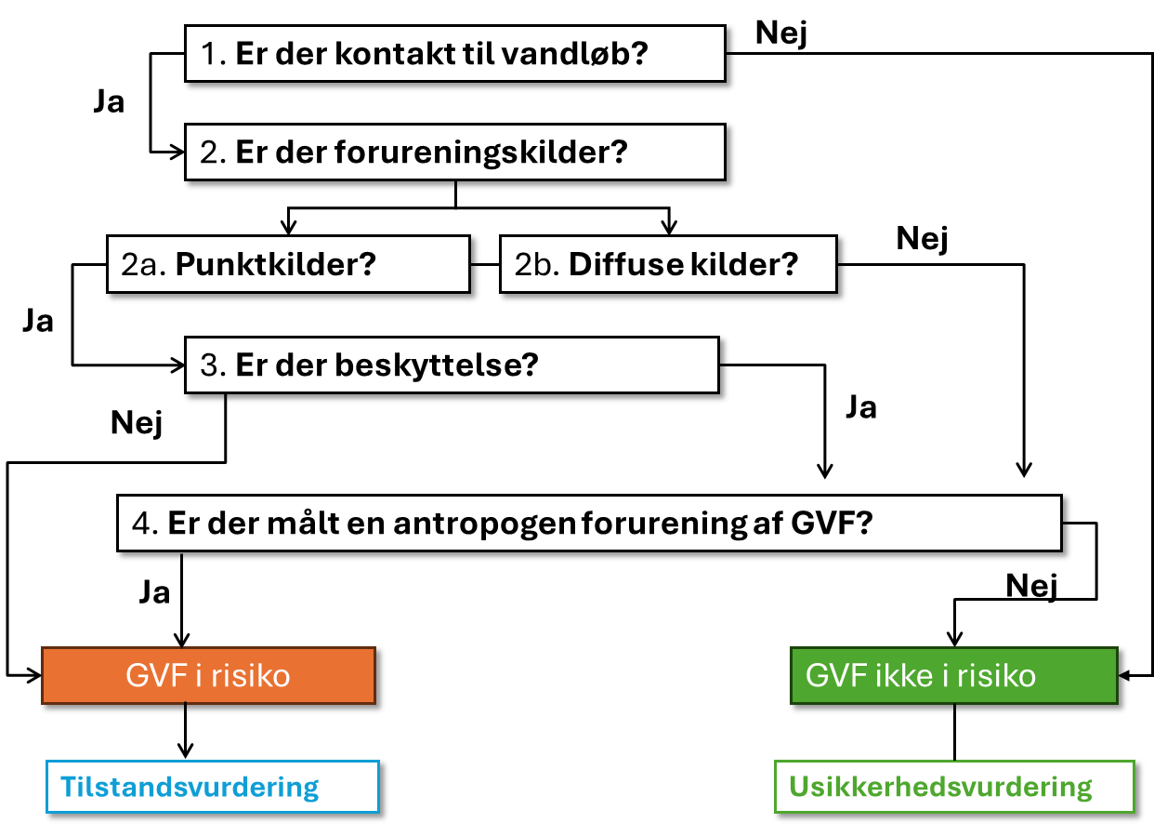
General risk assessment tree
(semi-quantitative sorting of gvf, contact with streams/rivers)
71% of GVF
29% of GVF
No flux
No MKK
Status: concept development (draft sent to SGAV, 23 May); decision on ambition-level pending.

Slide 3
General risk assessment tree
(semi-quantitative sorting of gvf, contact with streams/rivers)
29% of GVF
71% of GVF
Parameter-specific inventory of relevant point and diffuse sources within GVF area
Parameter-specific factors hindering transport from source to receptor (stream/river)
Check if there are anthropogenically influenced well-screens in the GVF
MAM > NBL
Increasing trend
Status: Incomplete draft sent to SGAV (23 May); focus on conceptual understanding for each parameter;
decision on ambition-level for the risk-assessment is pending.

Slide 4
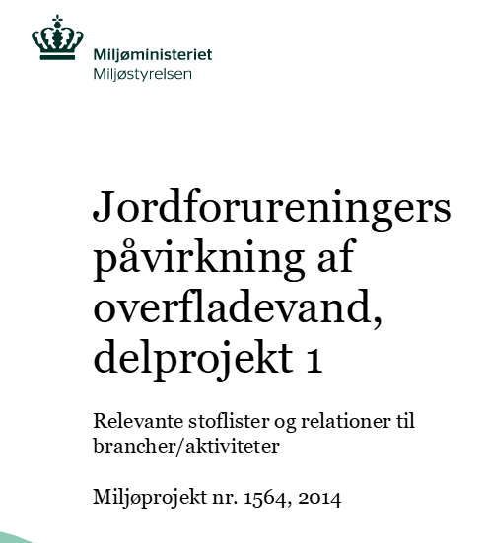
Parameter-specific inventory of relevant point and diffuse sources within GVF area
List with relevant parameter-specific pollution sources:
point sources: activities/branches (MST, 2014) or relevant basemap04 LULC classes (e.g. specific industry, transport etc.)
diffuse sources: relevant basemap04 LULC classes
Significant source in the context of the project:
point sources: XX m vertical/horizontal distance to GVF
diffuse sources: % area of GVF
If at least 1 relevant and significant source in the GVF → step 3
If not → step 4
Example
Relevant point sources:
V1/V2 (MST 2014):
Activity: metal galvanization (051)
Branche: Manufacture of lead, zinc and tin and their components (27.43.00)
OR Basemap4: industry (125000, 125110)
Relevant diffuse sources:
Agg. Areas where pig slurry or sludge was/is used as fertilizer
OR all agg. Related LULC codes from Basemap04
Urban runoff (plumbing, roofing) infiltration:
Basemap04: all codes for urban (built-up) areas
Diffuse or point source?
Zn

Slide 5
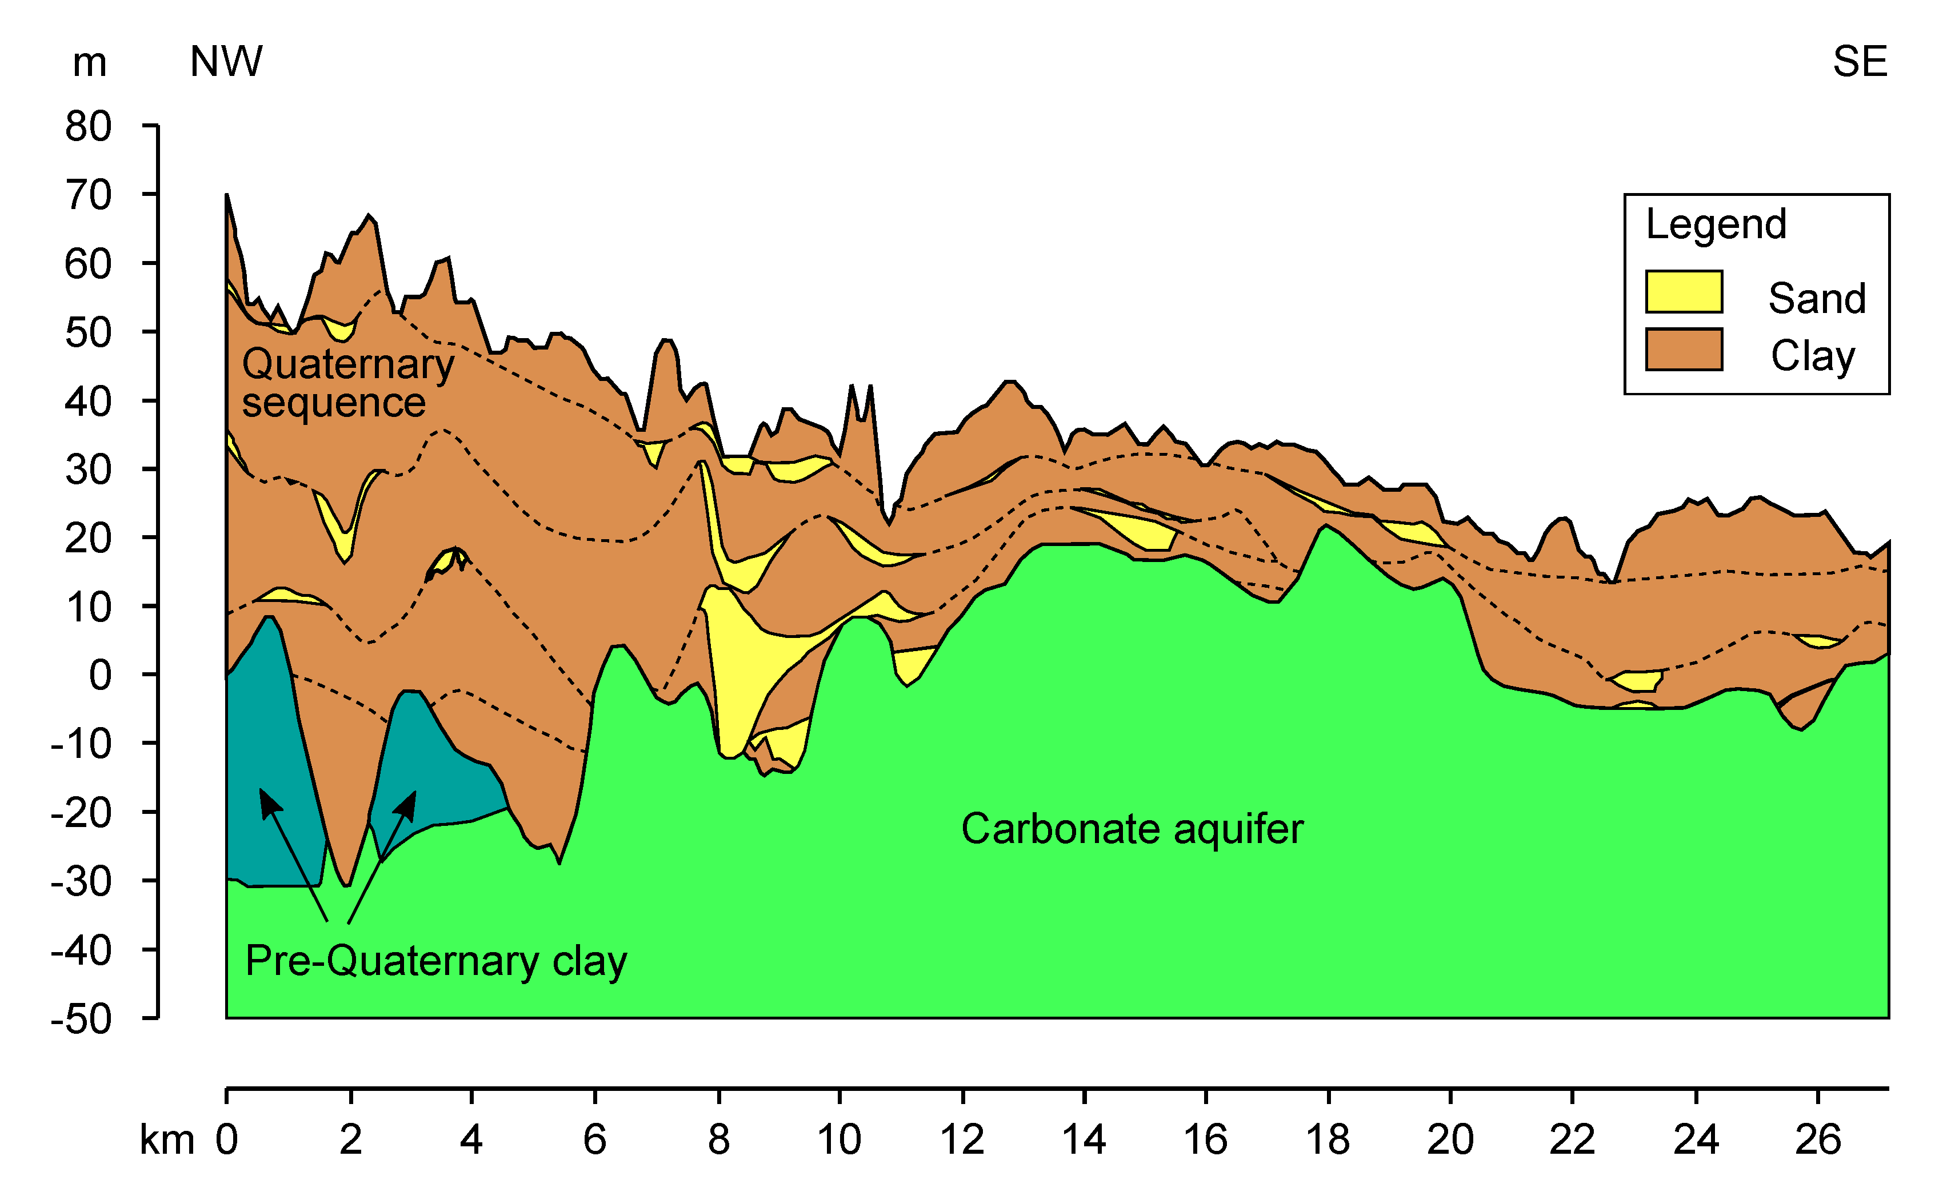
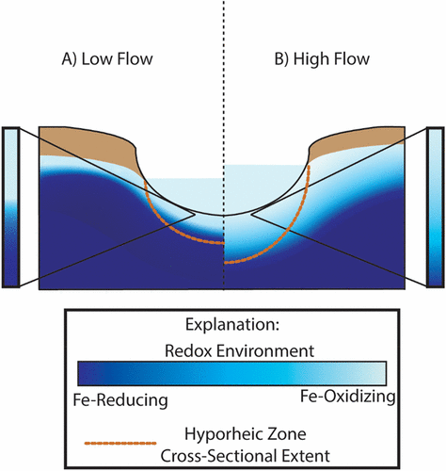
Parameter-specific factors hindering transport from source to receptor (stream/river)
The factors could include, for example:
Geochemical conditions (pH, redox, etc.)
Lithological characteristics: clay %, thickness of overlying clay, organic sediments, etc.
It should include both:
Protection of the GVF to pollution (from the identified sources)
Protection of the stream/river
Hyporheic zone – complex dynamic system (temporary sorption/desorption cycles)
Example
Zn sorption to clay, Fe/Mn oxides, organic matter
Mobility increases when:
Low pH (acidic soils/sediments, low buffering capacity)
Oxidized conditions
Sediments with low sorption capacity, low clay content
Changes in redox conditions (sorption/desorption)
Saline intrusion
Zn

Slide 6
Step 4 ensures that GVF are not misclassified in step 2 and 3 due to limitations in our:
knowledge about the pollution sources or
conceptual understanding about protecting factors.
Check if there is a well-screen with:
MAM concentration > NBL
(Increasing trend ?)
Example
NBLs for groundwater: 3-75 ug/L
No NBL exceeds the national gw TV for Zn (100 ug/l)
The highest NBLs were found:
On Bornholm
In oxic Quaternary sand on Jutland (with low pH) and on Zealand (with high pH).
Trends – not discussed yet
Potentially, it should be a combination with the concentration level
Zn

Slide 7
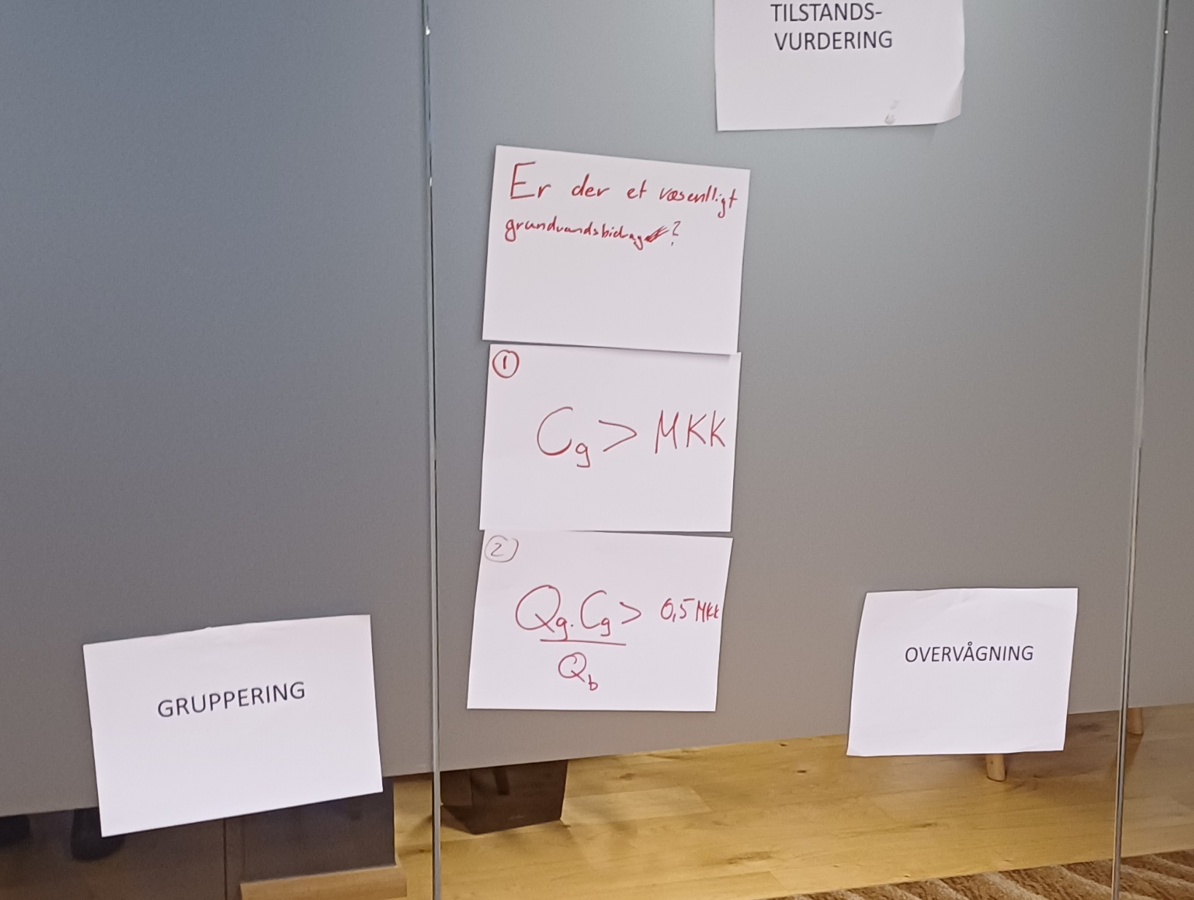
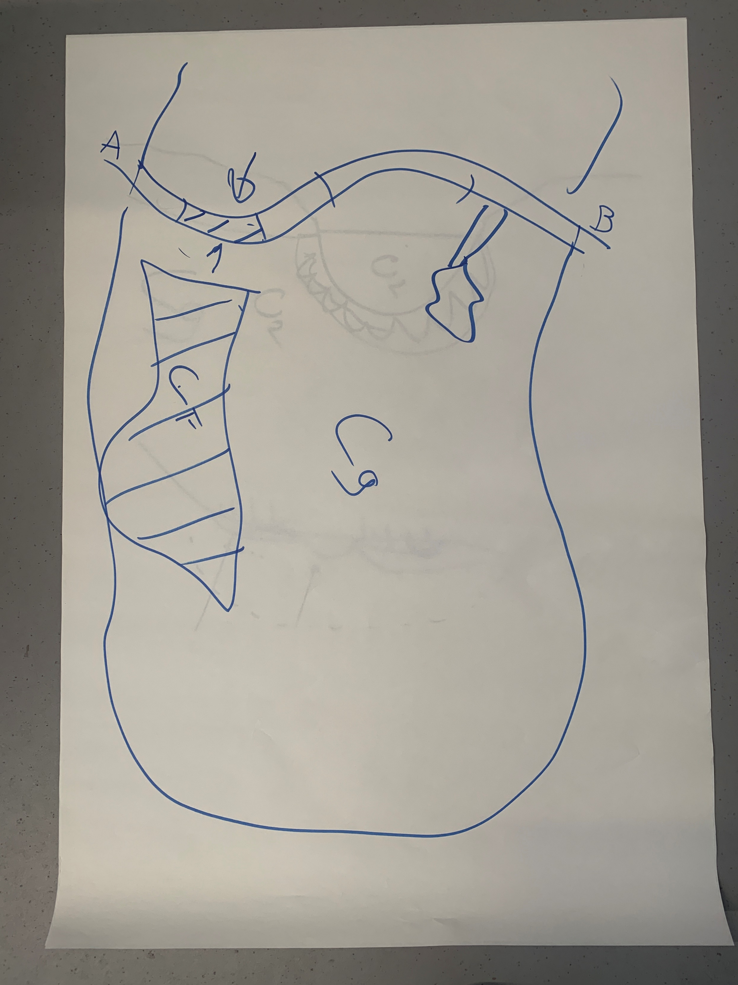
Status assessment (where the MKK and the flux are relevant)
Workshop (Dec 2024)
Cg – gw concentration
Qb – discharge at B (?)
Tilstandsvurdering.jpg
Skitse angagelser af kildens placering ift ovf.jpg
”Grundvandet skal bidrage med over 50 % af den load, som skal til for at MKK overskrides. (Mødereferat 10-12-2024)”

